Slide 1

Paytm Canada
1 Richmond Street W.Suite #200
Toronto, ON

Slide 2












PREVIOUS DATATHON PARTNERS
Notes:
Here are just some of the organization we’ve helped over the last 5 years. You’ll probably recognize some of the names up there (UNICEF, Greenpeace) and there’s probably some you may not have heard of before. The point here is we work with NFPs of all sizes and in all kinds of sectors, which means our members get to work on interesting and varied problems.

Slide 3

Check out our new leadership roles for 2020!
We are looking for more ambitious folks who care about making an impact.
Apply Today!! https://t.co/h9o7tIW4gj

Slide 4
Day 1 AGENDA
1. Registration + check-in 18:00 – 18:30
2.Presentations + Q&A session 18:30 – 19:00
- Data for Good
- Event Sponsor: PayTM
- Featured NFP: KHP
3. Group Formations + Preparation + Exploratory Data Analysis 19:30 - 21:00
Your Turn
Notes:
Welcome … thank you for coming out to our first event of the year … How many are new members?… as many of you are new members to the group, we’re going to kick things off with a quick presentation about Data For Good, who we are, what we do and how YOU can get involved.

Slide 5

Event Sponsor

Slide 6
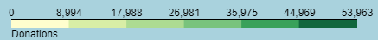
Some Good News First!
Youth Without Shelter
Used analyses and visualizations from our Datathon for validating characteristics of their high-volume groups to concentrate donor engagement and activities.

Slide 7
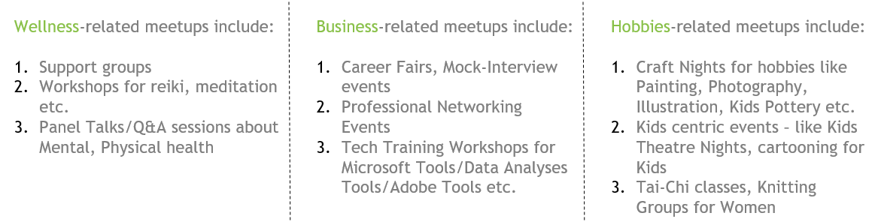
Some Good News First!
East End United
Our First Datathon with 100% Open Data – extracted from Meetup.com, Eventbrite.com, Eventful.com and Census data from Statistics Canada

Slide 8

Featured NFP
https://kidshelpphone.ca/

Slide 9
KHP Datathon Objectives
1. Generate a map of segmented profiles of current KHP walkers/donors using geographical data from StatsCan and existing walkers/donors data
2. Identify the most loyal and consistent walkers/donors starting from 2010, such as those who have given at least 7 times in the past 5 years; or those who have cumulative giving of above $500 over the years
3. Identify the profile of lapsed, new and returning Walkers/Donors

Slide 10
KHP Datathon Motivation
(*start with calculating the following metrics if you have difficulties with directly approaching the Objectives)
Through this Datathon, Kids Help Phone wants better insights into their walker/donor behaviour.
Volume of donations
Year-On-Year growth of donations
Walker participation/engagement rate – Examples
Retention rate
Optimal communication times for fundraisers
Best time to open registration for fundraisers
Other interesting features that are visible only to data-experts

Slide 11
Mapping Donor Segmentation
What is Segmentation?
Segmentation is a strategy through which a nonprofit can split its volunteer or donor population into smaller segments that are influenced by their location, generational grouping, gender, race, education level, and more.
Common Purposes of Segmentation: 1. Customize appeals to different segments : a donor who contributed $250 six months ago should receive a different message than the donor who contributed $25 a year ago 2. Determine which donors are more likely to respond to a request for a monthly gift; which donors are no longer worth mailing to; which prospects are more likely to make a gift to an issue etc.
RFM Model
The RFM model is a type of segmentation model, used to evaluate the Giving Behavior of a Donor.
R = Recency refers to the time when a donor made the last donation
F = Frequency is how often are payments made
M = Monetary Value is the sum of all donations

Slide 12
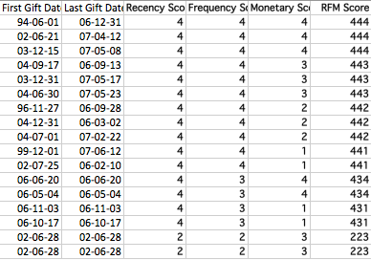
Recommendation 1:
Rank the donors list by the date of their last gift. Those who gave most recently, (this fiscal year) get a recency score of 5. Those who gave last fiscal year will be ranked 4 and so on...
Next re-rank donors by how often they give on the frequency scale, again ranking them from 5 for the most frequent times they have given to 1 for the least frequent times they gave in the last 5 years.
Finally repeat the process using the highest donation amount (monetary value)
Champions
Potential Champions
Loyalists
Potential Loyalists
New Customers
At Risk!

Slide 13
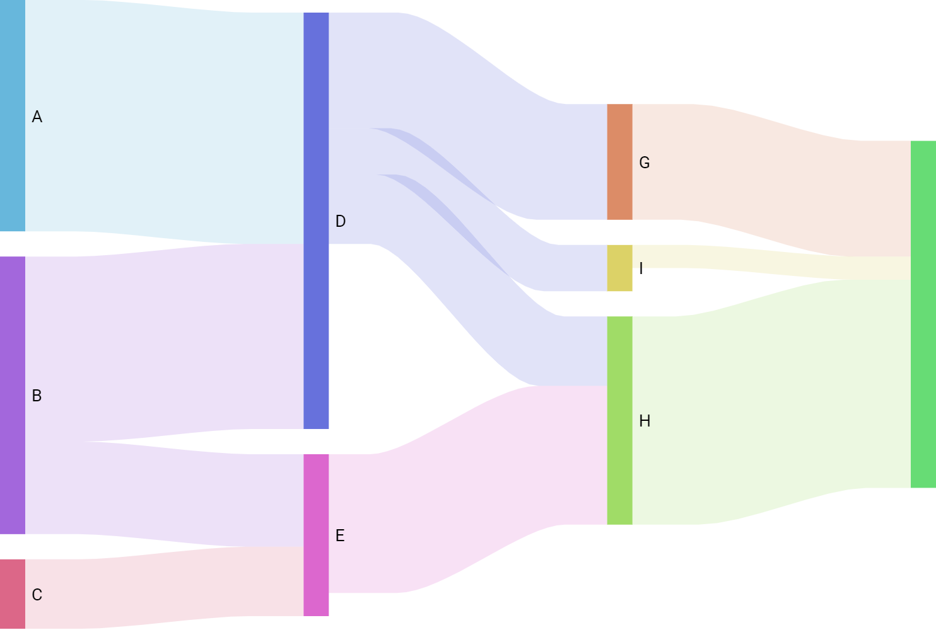
Recommendation 2:
Sankey Diagram
Why Sankey?
A Sankey Diagram based visualization allows to display continuity and flows. Each entity is represented by rectangles and arcs have a width proportional to their importance
Resources to get Started:
https://www.data-to-viz.com/graph/sankey.html
Python : https://plot.ly/python/sankey-diagram/
Tableau: https://www.theinformationlab.co.uk/2018/03/09/build-sankey-diagram-tableau-without-data-prep-beforehand/

Slide 14
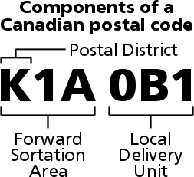
Data - Walkthrough
What is FSA?
Walkthrough Downloading Data
Data Available
Access to Census Data – 2006 to 2016 Census Years
Walkers CSV File
Donors CSV File
Donations Linked to Walkers.txt

Slide 15
Levels of Detail in Census Data Over the Years
Census Categories
Age and Sex
Family Type, Household & Marital Status
Labour
Immigration & Citizenship
Education
Languages Spoken
Count of Population in Each Category
Ethnic Origin
Visible Minority
Income Levels
Mobility

Slide 16
Building a Proof of Concept
Dash Web App
Getting Started : https://plot.ly/dash/
Datacamp’s tutorial : https://www.datacamp.com/community/tutorials/learn-build-dash-python
Dash Dashboards with Code : https://medium.com/plotly/7-new-dash-apps-made-by-the-dash-community-196998112ce3

Slide 17
Non Profit Data 101
Non Profit data is the same but different than corporate data
We use a CRM
Constituent Relationship Management
Kids Help Phone uses the most common program – The Raiser’s Edge
All data is from Kids Help Phone Raiser’s Edge Data
Privacy is very important to all non profits in Canada

Slide 18
Walker Data
A walker is someone who walked for Kids Help Phone
Each Walker has a unique Constituent ID

Slide 19
Donor Data
A donor is someone who donated to one or more walkers
Each donor has a unique constituent ID
Each donation has a unique donation ID
A donor could have many donations

Slide 20
Donations linked to Walker
This file is a linking table between the donors and walkers
Gift Import ID – is the link to the Gift Import ID from the Donors File
Walker Constituent ID – is the link to the Walker File

Slide 21
Take-home Datathon Format
November 19, 2019
Day 1 at PayTM – Network, form your team and do some Exploratory Data Analysis!
Use this time efficiently so you can ask Kids Help Phone as many questions as possible in person or on Slack.
November 19 2019 to November 24, 2019
Collaborate with your teammates and complete your analyses
5PM, November 25, 2019
Submit your presentations – Add them to the Final Presentations folder in google Drive :
(Only registered Datathon attendees will have access to this Folder. Message us on Slack if you are a registered attendee but still don’t have access to it.)
November 26, 2019
Day 2 at Intelliware – Each team will be given 10 mins to present their findings and ~5 mins Q&A time. Kids Help Phone will also be there and may have questions about your insights/analysis.
Even if you were not able to have conclusive findings it would be nice to know your discovery process and what you learned.
Notes:
Welcome … thank you for coming out to our first event of the year … How many are new members?… as many of you are new members to the group, we’re going to kick things off with a quick presentation about Data For Good, who we are, what we do and how YOU can get involved.

Slide 22
DOs
Think outside the Box!
Ask questions, NFP reps are here to help
Use reproducible tools e.g. Tableau, MS Excel, R , Jupyter Notebooks, PowerBI
Work in groups (recommended at least 2 people in a group)
BE NICE AND HAVE FUN !
DONTs
Upload data to public places

Slide 23




STAY CONNECTED !
#dataforgood
@dataforgoodyyz
meetup.com/DataforGood
http://dataforgood.ca/
toronto@dataforgood.ca

